Slide 1
Technical codes of Media Narratives

Slide 2
Learning Intention
To understand the technical codes of filmmaking and analyse a film sequence using CAMELS.

Slide 3
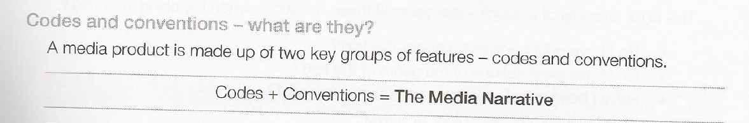
Technical Codes

Slide 4
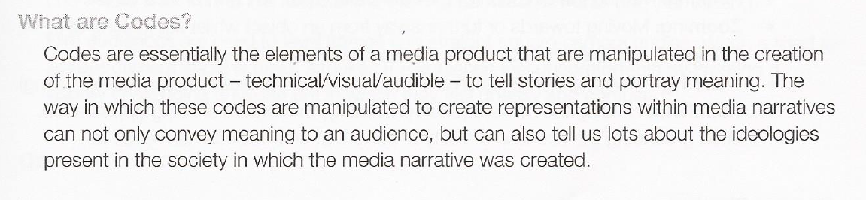
What are Technical codes?

Slide 5
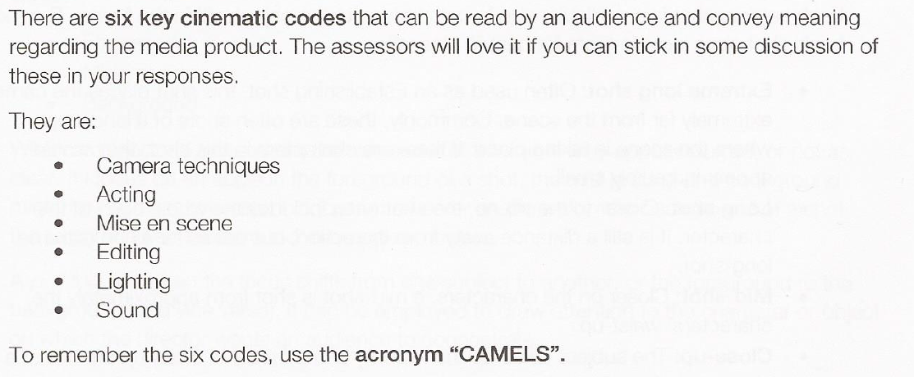
CAMELS

Slide 6

Think Camels
Camera
Sound
Acting
Lighting
Mise en Scene

Slide 7
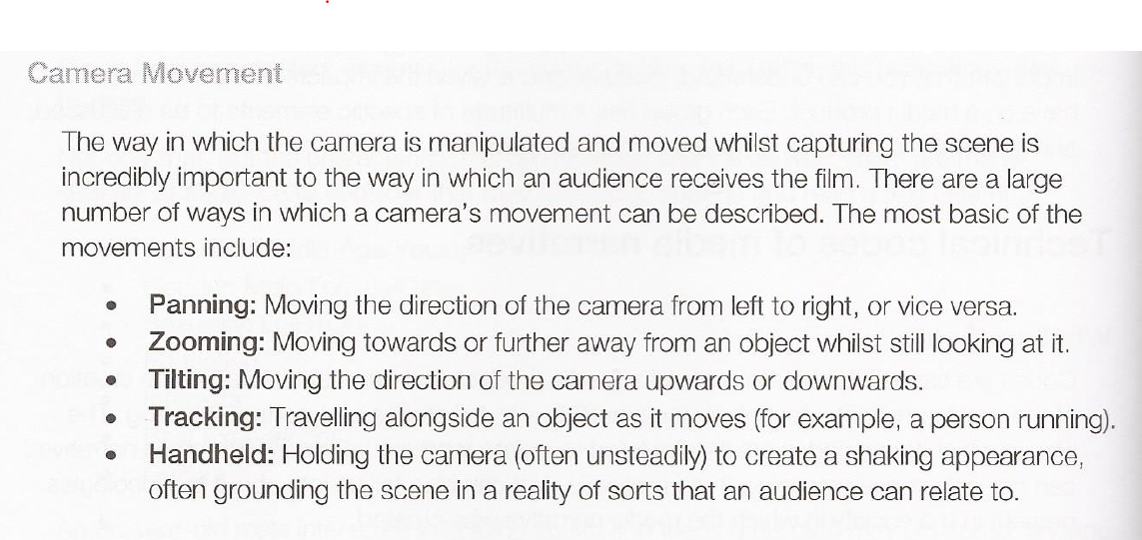
Camera

Slide 8
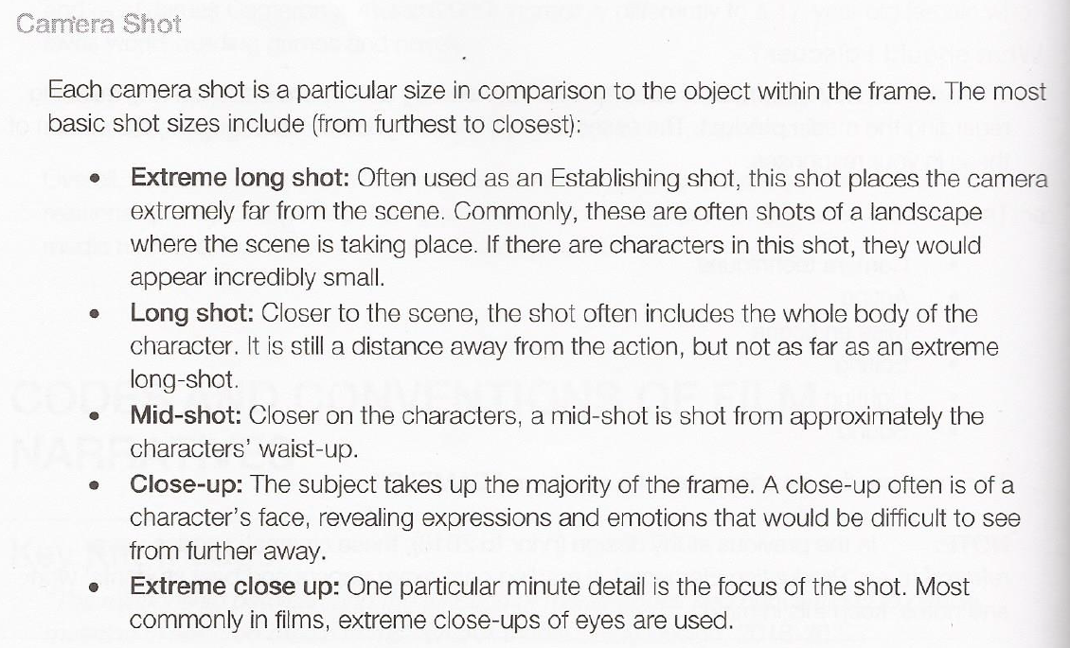

Slide 9
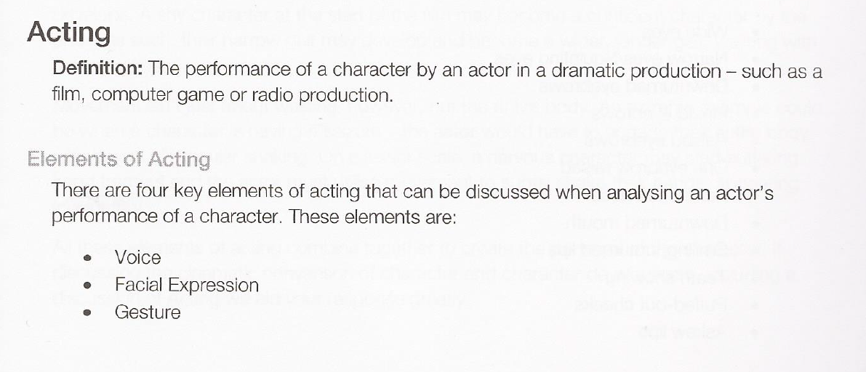
Acting

Slide 10
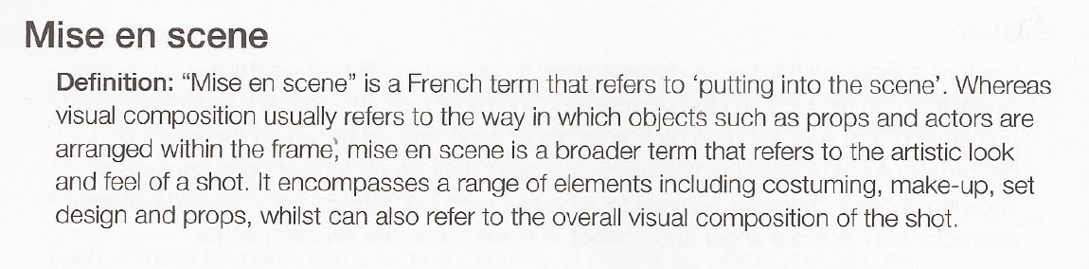
Mise en scene

Slide 11
Elements of Mise en scene
Props
Costume & Make-up
Visual Composition – rule of thirds
Colour

Slide 12
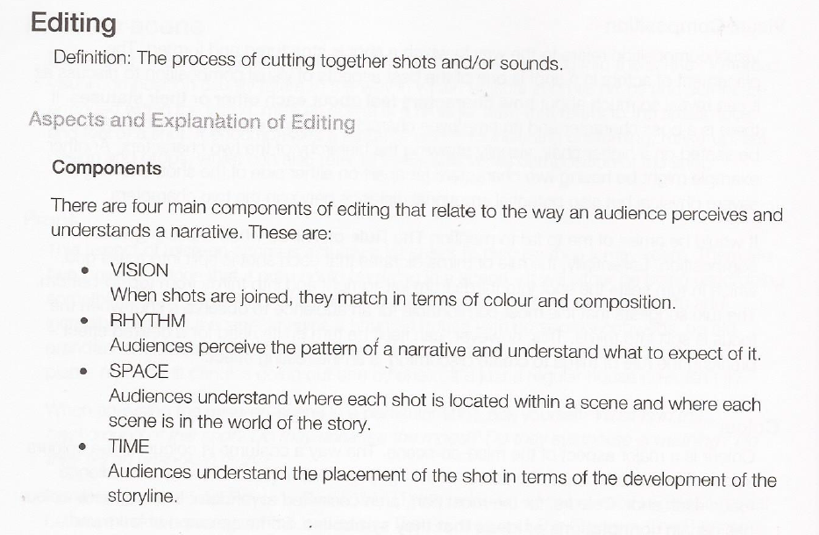
Editing

Slide 13
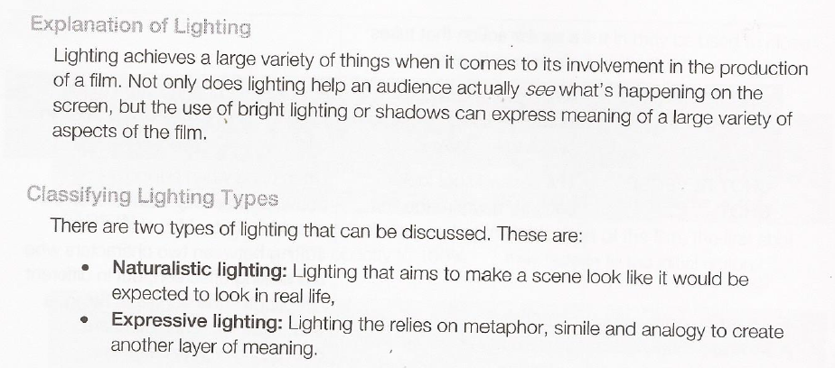
Lighting

Slide 14
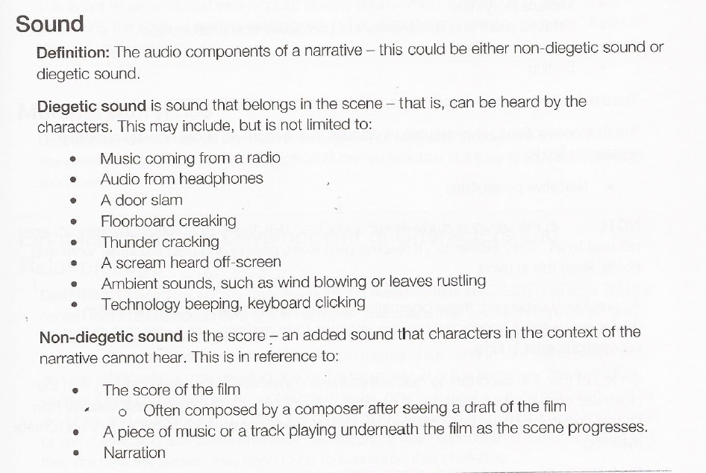
Sound

Slide 15

Watch & Analyse
Clip #1
Rabbit Proof Fence
https://vimeo.com/339466584

Slide 16

Watch & Analyse
Clip #2
The Dark Knight Rises
https://www.youtube.com/watch?v=nppON29OZ_4

Slide 17
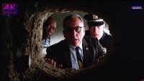
Watch & Analyse
Clip #3
Shawshank Redemption
https://www.youtube.com/watch?v=b_sAEfB9aTA

